Slide 1
Welcome to WE Bridge International
The 4th Partners’ Meeting
Cardiff, Wales
9th -11th of October 2014

Slide 2
West- East Bridge
Bridging Business, Language and Cultures

Slide 3
Symbols:
an action, object, event, etc., that expresses or represents a particular idea or quality
a letter, group of letters, character, or picture that is used instead of a word or group of words
(Webster dictionary)

Slide 4
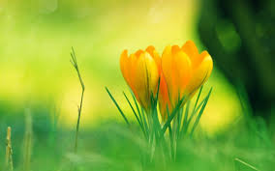
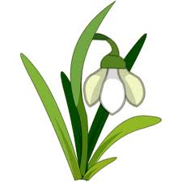
Which of these symbols does not belong to the country?
Wales
England
Scotland
Ireland

Slide 5
Which of these symbols does not belong to the country?
Wales
England
Scotland
Ireland

Slide 6
Match symbols with their meaning
The 7th century king of Gwynedd, Cadwaladr, is said to have ordered his men into battle wearing these for identification purposes, but whatever the origins, we grow plenty of them and they taste lovely
The origins of this symbol of Wales appear to be as an attractive interloper, introduced during the 19th century, as a replacement for the humble leek. David Lloyd George, the only Welshman to serve as Prime Minister, was a public advocate of this symbol and its appearance in early spring as a symbol of nature’s optimism coincides with St David’s Day on March 1.

Slide 7
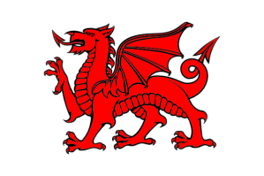
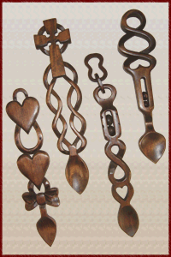
This is sometimes used as an alternative to the national one (and used in part of Crusaders' crest), and is flown on St David's Day
The significance of this symbol is believed to date back to Arthurian legend when Merlin had a vision of it (representing native Britons) fighting a white one (the Saxon invaders). The red one won the battle, just in case you were wondering…
A handcrafted gift made of a solid block of wood for a young woman indicated to the woman’s family that the man was skilled and capable with his hands. The oldest existing one in Wales dates back to 1667 and can be seen at the wonderful St Fagan’s: National History Museum.

Slide 8
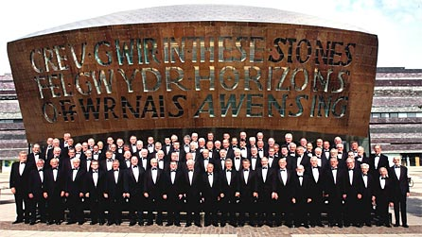
This symbol has three rows of strings rather than one. The Italians invented it during the 17th century, but a 100 years later it was widely known as the Welsh one. Other varieties are believed to have been used in Wales since the 11th century and gifted exponents of the art, such as Elinor Bennett and Catrin Finch among others, continue to inspire audiences and aspiring musicians
It has become a very well-known symbol of Wales since winning a major national event for many consecutive years in the 1870s.
The first Welsh international one took place in 1881 against England, in Blackheath. It didn't go well for the away team, but brushing that minor setback aside, the first golden era came with a three year unbeaten run between 1907 and 1910. Today it is one of the most important symbols for Wales.

Slide 9
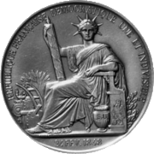
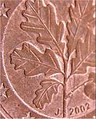
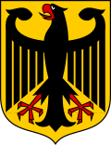
FRANCE
GERMANY

Slide 10
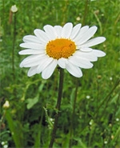
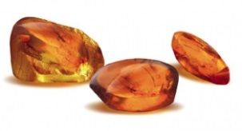
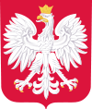
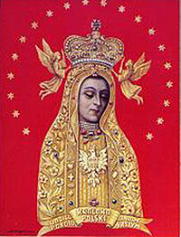
LATVIA
POLAND

Slide 11
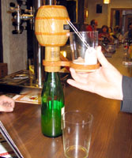
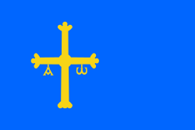
SPAIN

Slide 12
In your groups create a new symbol you would like your country to have
Draw the symbol/explain what it is
Tell the other groups why you have chosen this symbol and why you think it is representative for your country.

Slide 13
Thank you
The 4th Partners’ Meeting
Cardiff, Wales
9th -11th of October 2014

